Slide 1
Semi-supervised Learning

Slide 2
Slide credits
Most of these slides were adapted from:
Hung-yi Lee (National Taiwan University)
Kris Kitani (Carnegie Mellon University).
Noah Snavely (Cornell University).
Fei-Fei Li (Stanford University).

Slide 3
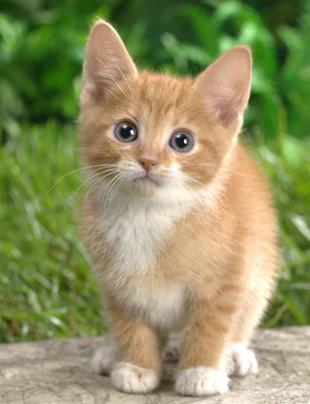
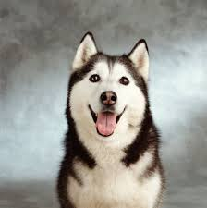
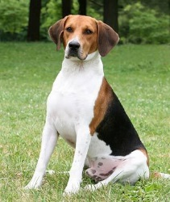
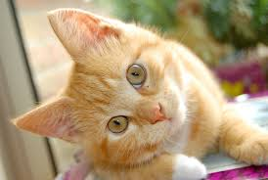
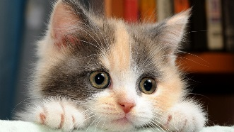
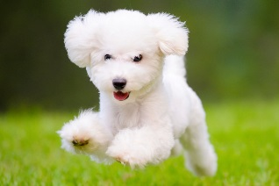
Introduction
Labelled data
cat
dog
Unlabeled data
(Image of cats and dogs without labeling)

Slide 4
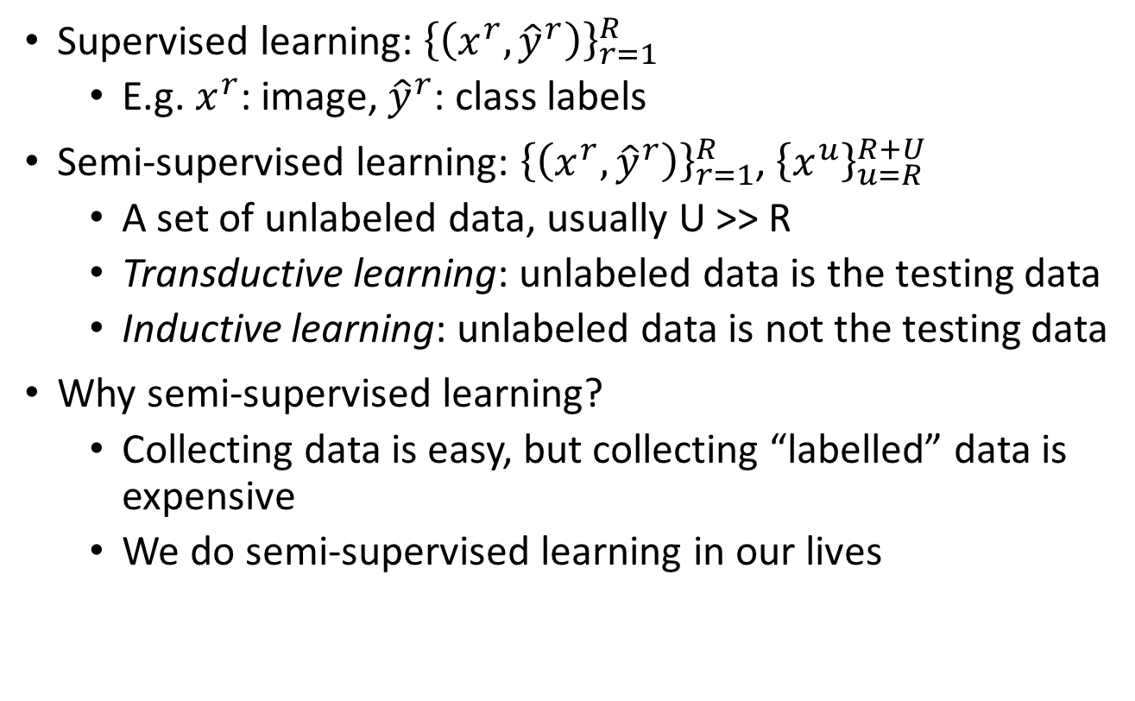
Introduction
Supervised learning: ${\left\{\left(x^{r},{\hat{y}}^{r}\right)\right\}}_{r=1}^{R}$
E.g. $x^{r}$: image, ${\hat{y}}^{r}$: class labels
Semi-supervised learning: ${\left\{\left(x^{r},{\hat{y}}^{r}\right)\right\}}_{r=1}^{R}$, ${\left\{x^{u}\right\}}_{u=R}^{R+U}$
A set of unlabeled data, usually U >> R
Transductive learning: unlabeled data is the testing data
Inductive learning: unlabeled data is not the testing data
Why semi-supervised learning?
Collecting data is easy, but collecting “labelled” data is expensive
We do semi-supervised learning in our lives

Slide 5
Why semi-supervised learning helps?
Who knows?
The distribution of the unlabeled data tell us something.
Usually with some assumptions
Notes:
Peesuod-labels

Slide 6
Outline
Low-density Separation Assumption
Smoothness Assumption
Semi-supervised Learning for Generative Model
Better Representation
Notes:
Generating pseudo-labels for unlabeled data
Where to put cluster and label

Slide 7
Semi-supervised Learning for Generative Model

Slide 8
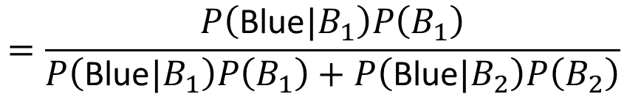
Two Boxes
Box 1
Box 2
P(B₁) = 3/5
P(B₂) = 2/5
P(Blue|B₁) = 4/5
P(Blue|B₁) = 2/5
P(Green|B₁) = 1/5
P(Green|B₁) = 3/5
from one of the boxes
Where does it come from?
$$=\frac{P\left(\text{Blue}|B_{1}\right)P\left(B_{1}\right)}{P\left(\text{Blue}|B_{1}\right)P\left(B_{1}\right)+P\left(\text{Blue}|B_{2}\right)P\left(B_{2}\right)}$$
P(B₁ | Blue)

Slide 9
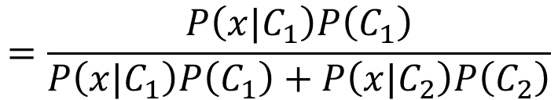



Two Classes
Estimating the Probabilities
From training data
Class 1
Class 2
P(C₁)
P(C₂)
P(x|C₁)
P(x|C₂)
Given an x, which class does it belong to
$$=\frac{P\left(x|C_{1}\right)P\left(C_{1}\right)}{P\left(x|C_{1}\right)P\left(C_{1}\right)+P\left(x|C_{2}\right)P\left(C_{2}\right)}$$
$$P\left(C_{1}|x\right)$$
Generative Model
$$P\left(x\right)$$
$$=P\left(x|C_{1}\right)P\left(C_{1}\right)+P\left(x|C_{2}\right)P\left(C_{2}\right)$$
Notes:
P(c) - prior, P(c|x) - posterior

Slide 10

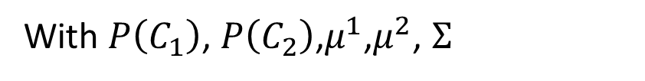
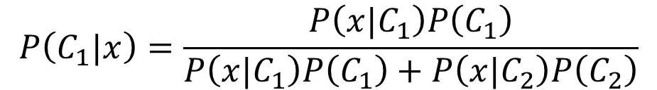


Supervised Generative Model
Given labelled training examples $x^{r}$ $∈$ $C_{1},C_{2}$
looking for most likely prior probability P(C_{i}) and class-dependent probability P(x|C_{i})
P(x|C_{i}) is a Gaussian parameterized by $μ^{i}$ and $Σ$
$$μ^{1},Σ$$
$$μ^{2},Σ$$
Decision Boundary
With $P\left(C_{1}\right)$, $P\left(C_{2}\right)$,$μ^{1}$,$μ^{2}$, $Σ$
$$P\left(C_{1}|x\right)=\frac{P\left(x|C_{1}\right)P\left(C_{1}\right)}{P\left(x|C_{1}\right)P\left(C_{1}\right)+P\left(x|C_{2}\right)P\left(C_{2}\right)}$$
Notes:
original

Slide 11

Semi-supervised Generative Model
Given labelled training examples $x^{r}$ $∈$ $C_{1},C_{2}$
looking for most likely prior probability P(C_{i}) and class-dependent probability P(x|C_{i})
P(x|C_{i}) is a Gaussian parameterized by $μ^{i}$ and $Σ$
$$μ^{1},Σ$$
$$μ^{2},Σ$$
Decision Boundary
The unlabeled data $x^{u}$ help re-estimate $P\left(C_{1}\right)$, $P\left(C_{2}\right)$, $μ^{1}$,$μ^{2}$, $Σ$
Notes:
original

Slide 12

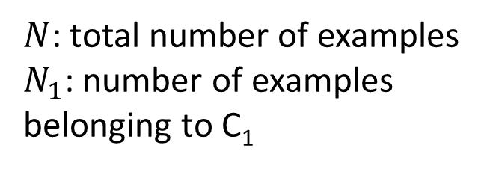

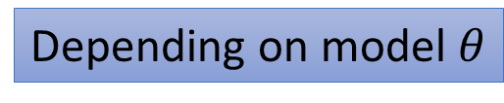
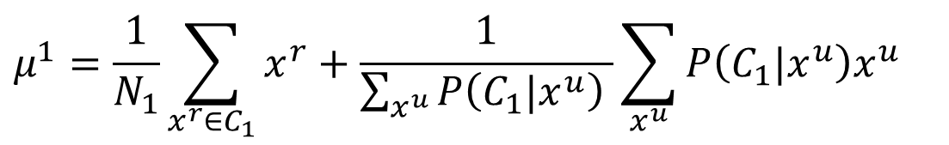
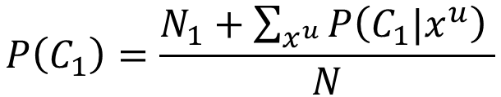
Semi-supervised Generative Model
The algorithm converges eventually, but the initialization influences the results.
Initialization:$θ=\left\{P\left(C_{1}\right)\text{,}P\left(C_{2}\right)\text{,}μ^{1}\text{,}μ^{2}\text{, }Σ\right\}$
Step 1: compute the posterior probability of unlabeled data
Step 2: update model
E
$$P_{θ}\left(C_{1}|x^{u}\right)$$
Depending on model $θ$
Back to step 1
M
$N$: total number of examples
$N_{1}$: number of examples belonging to C₁
$$P\left(C_{1}\right)=\frac{N_{1}+\sum_{x^{u}}{P\left(C_{1}|x^{u}\right) }}{N}$$
$$μ^{1}=\frac{1}{N_{1}}\sum_{x^{r}∈C_{1}}{x^{r}}+\frac{1}{\sum_{x^{u}}{P\left(C_{1}|x^{u}\right) }}\sum_{x^{u}}{P\left(C_{1}|x^{u}\right)x^{u}}$$
……

Slide 13
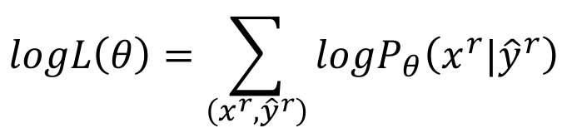
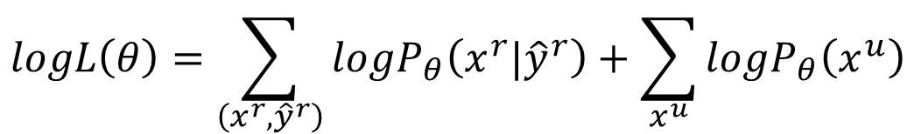
Why?
$$θ=\left\{P\left(C_{1}\right)\text{,}P\left(C_{2}\right)\text{,}μ^{1}\text{,}μ^{2}\text{, }Σ\right\}$$
Maximum likelihood with labelled data
Maximum likelihood with labelled + unlabeled data
$$logL\left(θ\right)=\sum_{\left(x^{r},{\hat{y}}^{r}\right)}{logP_{θ}\left(x^{r}|{\hat{y}}^{r}\right)}$$
$$logL\left(θ\right)=\sum_{\left(x^{r},{\hat{y}}^{r}\right)}{logP_{θ}\left(x^{r}|{\hat{y}}^{r}\right)}+\sum_{x^{u}}{logP_{θ}\left(x^{u}\right)}$$
Solved iteratively
$$P_{θ}\left(x^{u}\right)=P_{θ}\left(x^{u}|C_{1}\right)P\left(C_{1}\right)+P_{θ}\left(x^{u}|C_{2}\right)P\left(C_{2}\right)$$
($x^{u}$ can come from either C₁ and C₂)
Notes:
The truth is

Slide 14


Semi-supervised Learning Low-density Separation
“Black-or-white”
Notes:
https://www.cis.upenn.edu/~mkearns/papers/em-kmeans.pdf

Slide 15
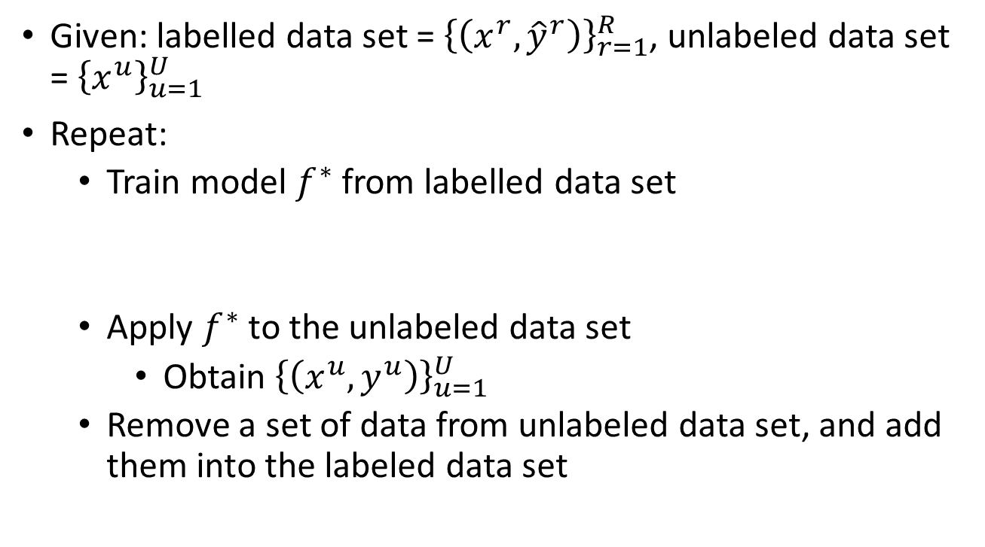
Self-training
Given: labelled data set = ${\left\{\left(x^{r},{\hat{y}}^{r}\right)\right\}}_{r=1}^{R}$, unlabeled data set = ${\left\{x^{u}\right\}}_{u=1}^{U}$
Repeat:
Train model $f^{∗}$ from labelled data set
Apply $f^{∗}$ to the unlabeled data set
Obtain ${\left\{\left(x^{u},y^{u}\right)\right\}}_{u=1}^{U}$
Remove a set of data from unlabeled data set, and add them into the labeled data set
You can use any model here.
Pseudo-label
How to choose the data set remains open
You can also provide a weight to each data.

Slide 16

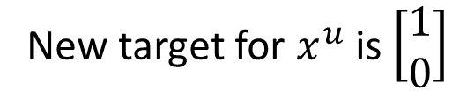

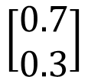
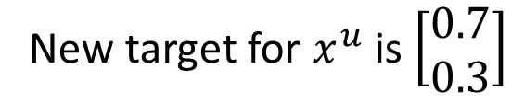
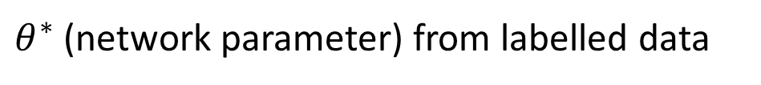
Self-training
Similar to semi-supervised learning for generative model
Hard label v.s. Soft label
Considering using neural network
$θ^{∗}$ (network parameter) from labelled data
Hard
Class 1
New target for $x^{u}$ is $\left[\begin{aligned}1 \\ 0\end{aligned}\right]$
$$x^{u}$$
$$θ^{∗}$$
$$\left[\begin{aligned}0.7 \\ 0.3\end{aligned}\right]$$
It looks like class 1, then it is class 1.
Soft
70% Class 1
30% Class 2
New target for $x^{u}$ is $\left[\begin{aligned}0.7 \\ 0.3\end{aligned}\right]$
Doesn’t work …

Slide 17
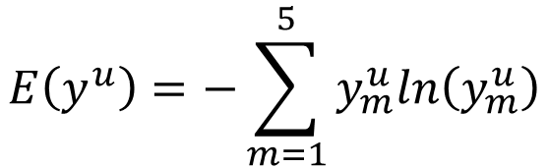





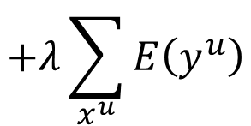



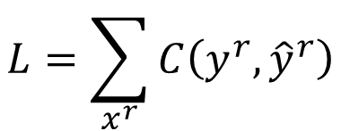


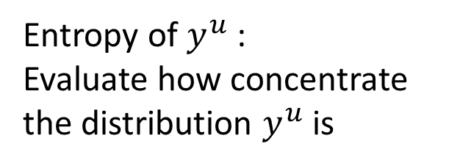
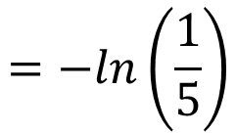
Entropy-based Regularization
Entropy of $y^{u}$:
Evaluate how concentrate the distribution $y^{u}$ is
$$x^{u}$$
$$θ^{∗}$$
$$y^{u}$$
Distribution
$$E\left(y^{u}\right)=−\sum_{m=1}^{5}{y_{m}^{u}ln\left(y_{m}^{u}\right)}$$
$$y^{u}$$
Good!
$$E\left(y^{u}\right)=0$$
1
2
3
4
5
As small as possible
$$y^{u}$$
Good!
$$E\left(y^{u}\right)=0$$
1
2
3
4
5
$$L=\sum_{x^{r}}{C\left(y^{r},{\hat{y}}^{r}\right)}$$
labelled data
Bad!
$$E\left(y^{u}\right)$$
$$y^{u}$$
$$=−ln\left(\frac{1}{5}\right)$$
$$+λ\sum_{x^{u}}{E\left(y^{u}\right)}$$
unlabeled data
1
2
3
4
5
$$=ln5$$

Slide 18
Outlook: Semi-supervised SVM
Enumerate all possible labels for the unlabeled data
Find a boundary that can provide the largest margin and least error
Thorsten Joachims, ”Transductive Inference for Text Classification using Support Vector Machines”, ICML, 1999
Notes:
https://www.cs.cornell.edu/people/tj/publications/joachims_99c.pdf
http://www.cs.cmu.edu/~guestrin/Class/10701-S06/Slides/tsvms-pca.pdf

Slide 19
Semi-supervised Learning Smoothness Assumption
“You are known by the company you keep”

Slide 20
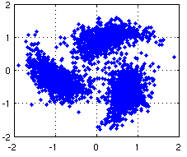
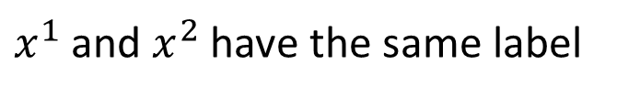
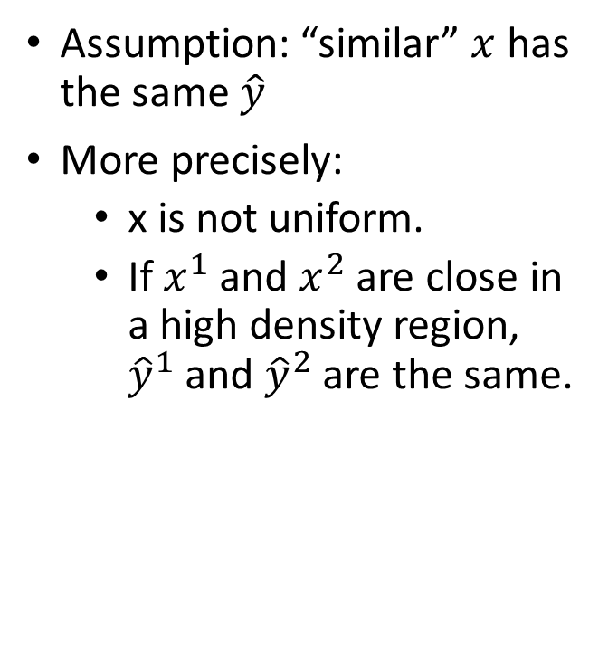



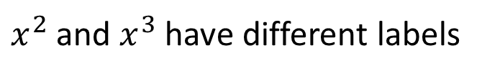
Smoothness Assumption
Assumption: “similar” $x$ has the same $\hat{y}$
More precisely:
x is not uniform.
If $x^{1}$ and $x^{2}$ are close in a high density region, ${\hat{y}}^{1}$ and ${\hat{y}}^{2}$ are the same.
$$x^{3}$$
$$x^{1}$$
$$x^{2}$$
connected by a high density path
$x^{1}$ and $x^{2}$ have the same label
Source of image: http://hips.seas.harvard.edu/files/pinwheel.png
$x^{2}$ and $x^{3}$ have different labels
Notes:
血輪演

Slide 21


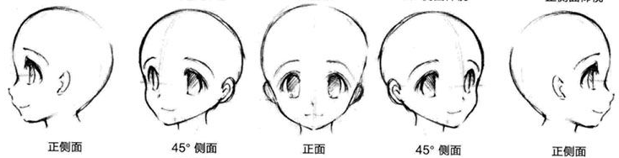
Smoothness Assumption
Not similar?
similar?
“indirectly” similar
with stepping stones
(The example is from the tutorial slides of Xiaojin Zhu.)
Source of image: http://www.moehui.com/5833.html/5/
Notes:
face recognition

Slide 22
Smoothness Assumption
Classify astronomy vs. travel articles
(The example is from the tutorial slides of Xiaojin Zhu.)

Slide 23
Smoothness Assumption
Classify astronomy vs. travel articles
(The example is from the tutorial slides of Xiaojin Zhu.)

Slide 24
Cluster and then Label
Cluster 2
Class 2
Class 1
Class 1
Class 2
Class 2
Cluster 1
Cluster 3
Using all the data to learn a classifier as usual

Slide 25

Graph-based Approach
How to know $x^{1}$ and $x^{2}$ are connected by a high density path
Represented the data points as a graph
Graph representation is nature sometimes.
E.g. Hyperlink of webpages, citation of papers
Sometimes you have to construct the graph yourself.

Slide 26

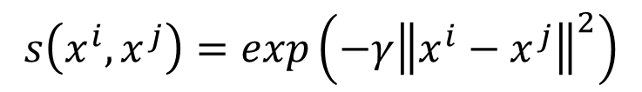
Graph-based Approach - Graph Construction
The images are from the tutorial slides of Amarnag Subramanya and Partha Pratim Talukdar
Define the similarity $s\left(x^{i},x^{j}\right)$ between $x^{i}$ and $x^{j}$
Add edge:
K Nearest Neighbor
e-Neighborhood
Edge weight is proportional to s$\left(x^{i},x^{j}\right)$
Gaussian Radial Basis Function:
$$s\left(x^{i},x^{j}\right)=exp\left(−γ{\left\|x^{i}−x^{j}\right\|}^{2}\right)$$

Slide 27
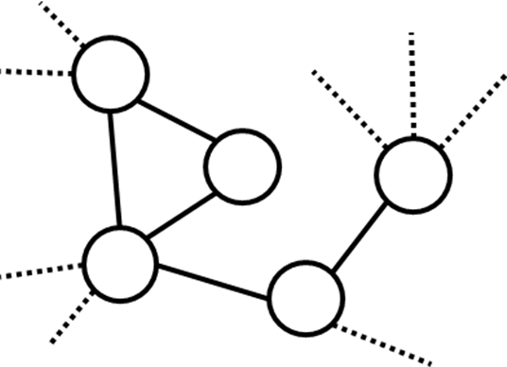
Graph-based Approach
Class 1
Class 1
Class 1
Class 1
Class 1
x
The labelled data influence their neighbors.
Propagate through the graph

Slide 28


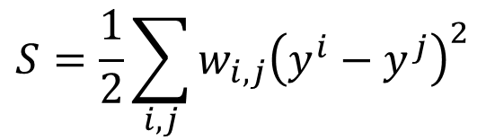








Graph-based Approach
Define the smoothness of the labels on the graph
$$S=\frac{1}{2}\sum_{i,j}{w_{i,j}{\left(y^{i}−y^{j}\right)}^{2}}$$
Smaller means smoother
For all data (no matter labelled or not)
$$y^{1}=1$$
x¹
$$y^{1}=0$$
x¹
3
3
2
2
$$y^{3}=1$$
$$y^{3}=1$$
x³
1
x³
1
x²
x²
$$y^{2}=1$$
$$y^{2}=1$$
1
1
x⁴
x⁴
$$S=0.5$$
$$S=3$$
$$y^{4}=0$$
$$y^{4}=0$$
Notes:
2 + 3 + 1
Assume lable a scalar

Slide 29
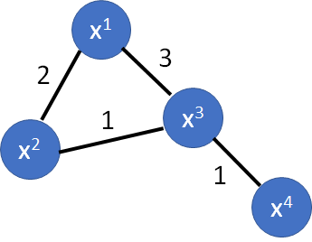





Graph-based Approach
Define the smoothness of the labels on the graph
$$S=\frac{1}{2}\sum_{i,j}{w_{i,j}{\left(y^{i}−y^{j}\right)}^{2}}$$
$$=y^{T}Ly$$
y: (R+U)-dim vector
$$y={\left[⋯y^{i}⋯y^{j}⋯\right]}^{T}$$
L: (R+U) x (R+U) matrix
Graph Laplacian
$$W=\left[\begin{matrix}\begin{matrix}0 & 2 \\ 2 & 0\end{matrix} & \begin{matrix}3 & 0 \\ 1 & 0\end{matrix} \\ \begin{matrix}3 & 1 \\ 0 & 0\end{matrix} & \begin{matrix}0 & 1 \\ 1 & 0\end{matrix}\end{matrix}\right]$$
$$D=\left[\begin{matrix}\begin{matrix}5 & 0 \\ 0 & 3\end{matrix} & \begin{matrix}0 & 0 \\ 0 & 0\end{matrix} \\ \begin{matrix}0 & 0 \\ 0 & 0\end{matrix} & \begin{matrix}5 & 0 \\ 0 & 1\end{matrix}\end{matrix}\right]$$
$$L=D−W$$
Notes:
8 + 75 + 9 + 16

Slide 30


Graph-based Approach
Define the smoothness of the labels on the graph
$$S=\frac{1}{2}\sum_{i,j}{w_{i,j}{\left(y^{i}−y^{j}\right)}^{2}}$$
Depending on model parameters
$$=y^{T}Ly$$
$$L=\sum_{x^{r}}{C\left(y^{r},{\hat{y}}^{r}\right)}$$
$$+λS$$
smooth
As a regularization term
J. Weston, F. Ratle, and R. Collobert, “Deep learning via semi-supervised embedding,” ICML, 2008
smooth
smooth
Notes:
https://github.com/CuriousAI/ladder
https://arxiv.org/pdf/1507.02672.pdf …..

Slide 31
Semi-supervised Learning Better Representation

Slide 32
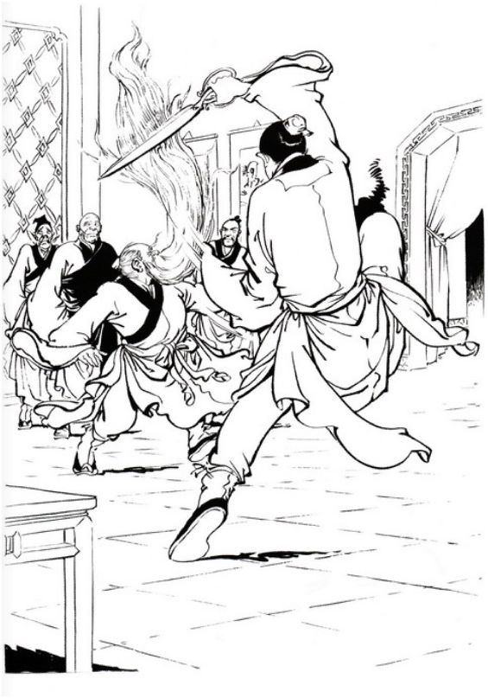
Looking for Better Representation
Find a better (simpler) representations from the unlabeled data
Original representation
Better representation
(In unsupervised learning part)

Slide 33
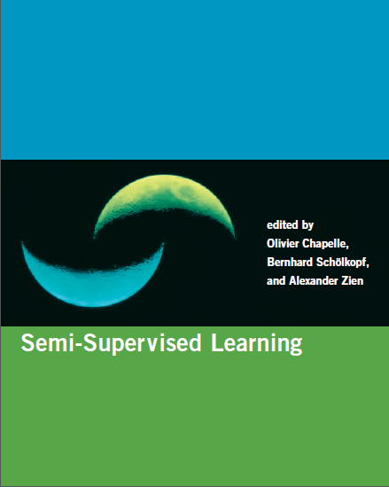
Reference
http://olivier.chapelle.cc/ssl-book/
Notes:
http://olivier.chapelle.cc/ssl-book/ssl_toc.pdf

